Slide 1
If our interpretation of what’s going on in the world is “a comparison of our raw perception with our preconceptions” (Wilczek 335) and if the fabric of reality is composed of harmonious structures, then analogy may have some discrete basis, and the pursuit of understanding across disciplines may lend insight to one’s hypothetical intuition.

Slide 2
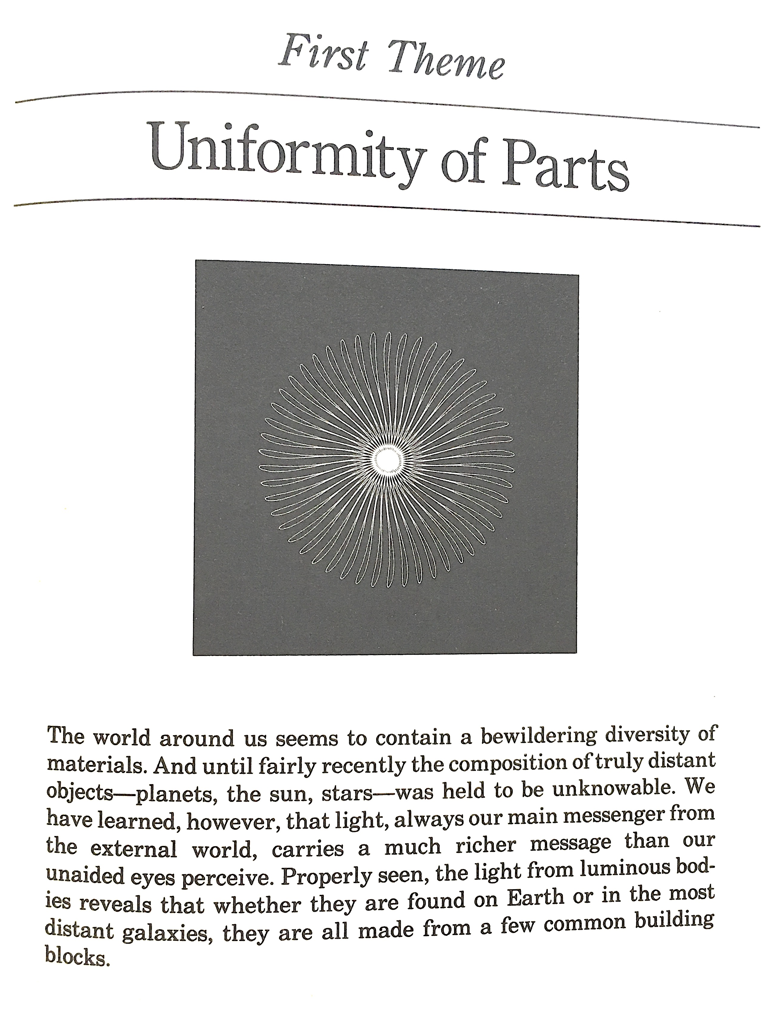
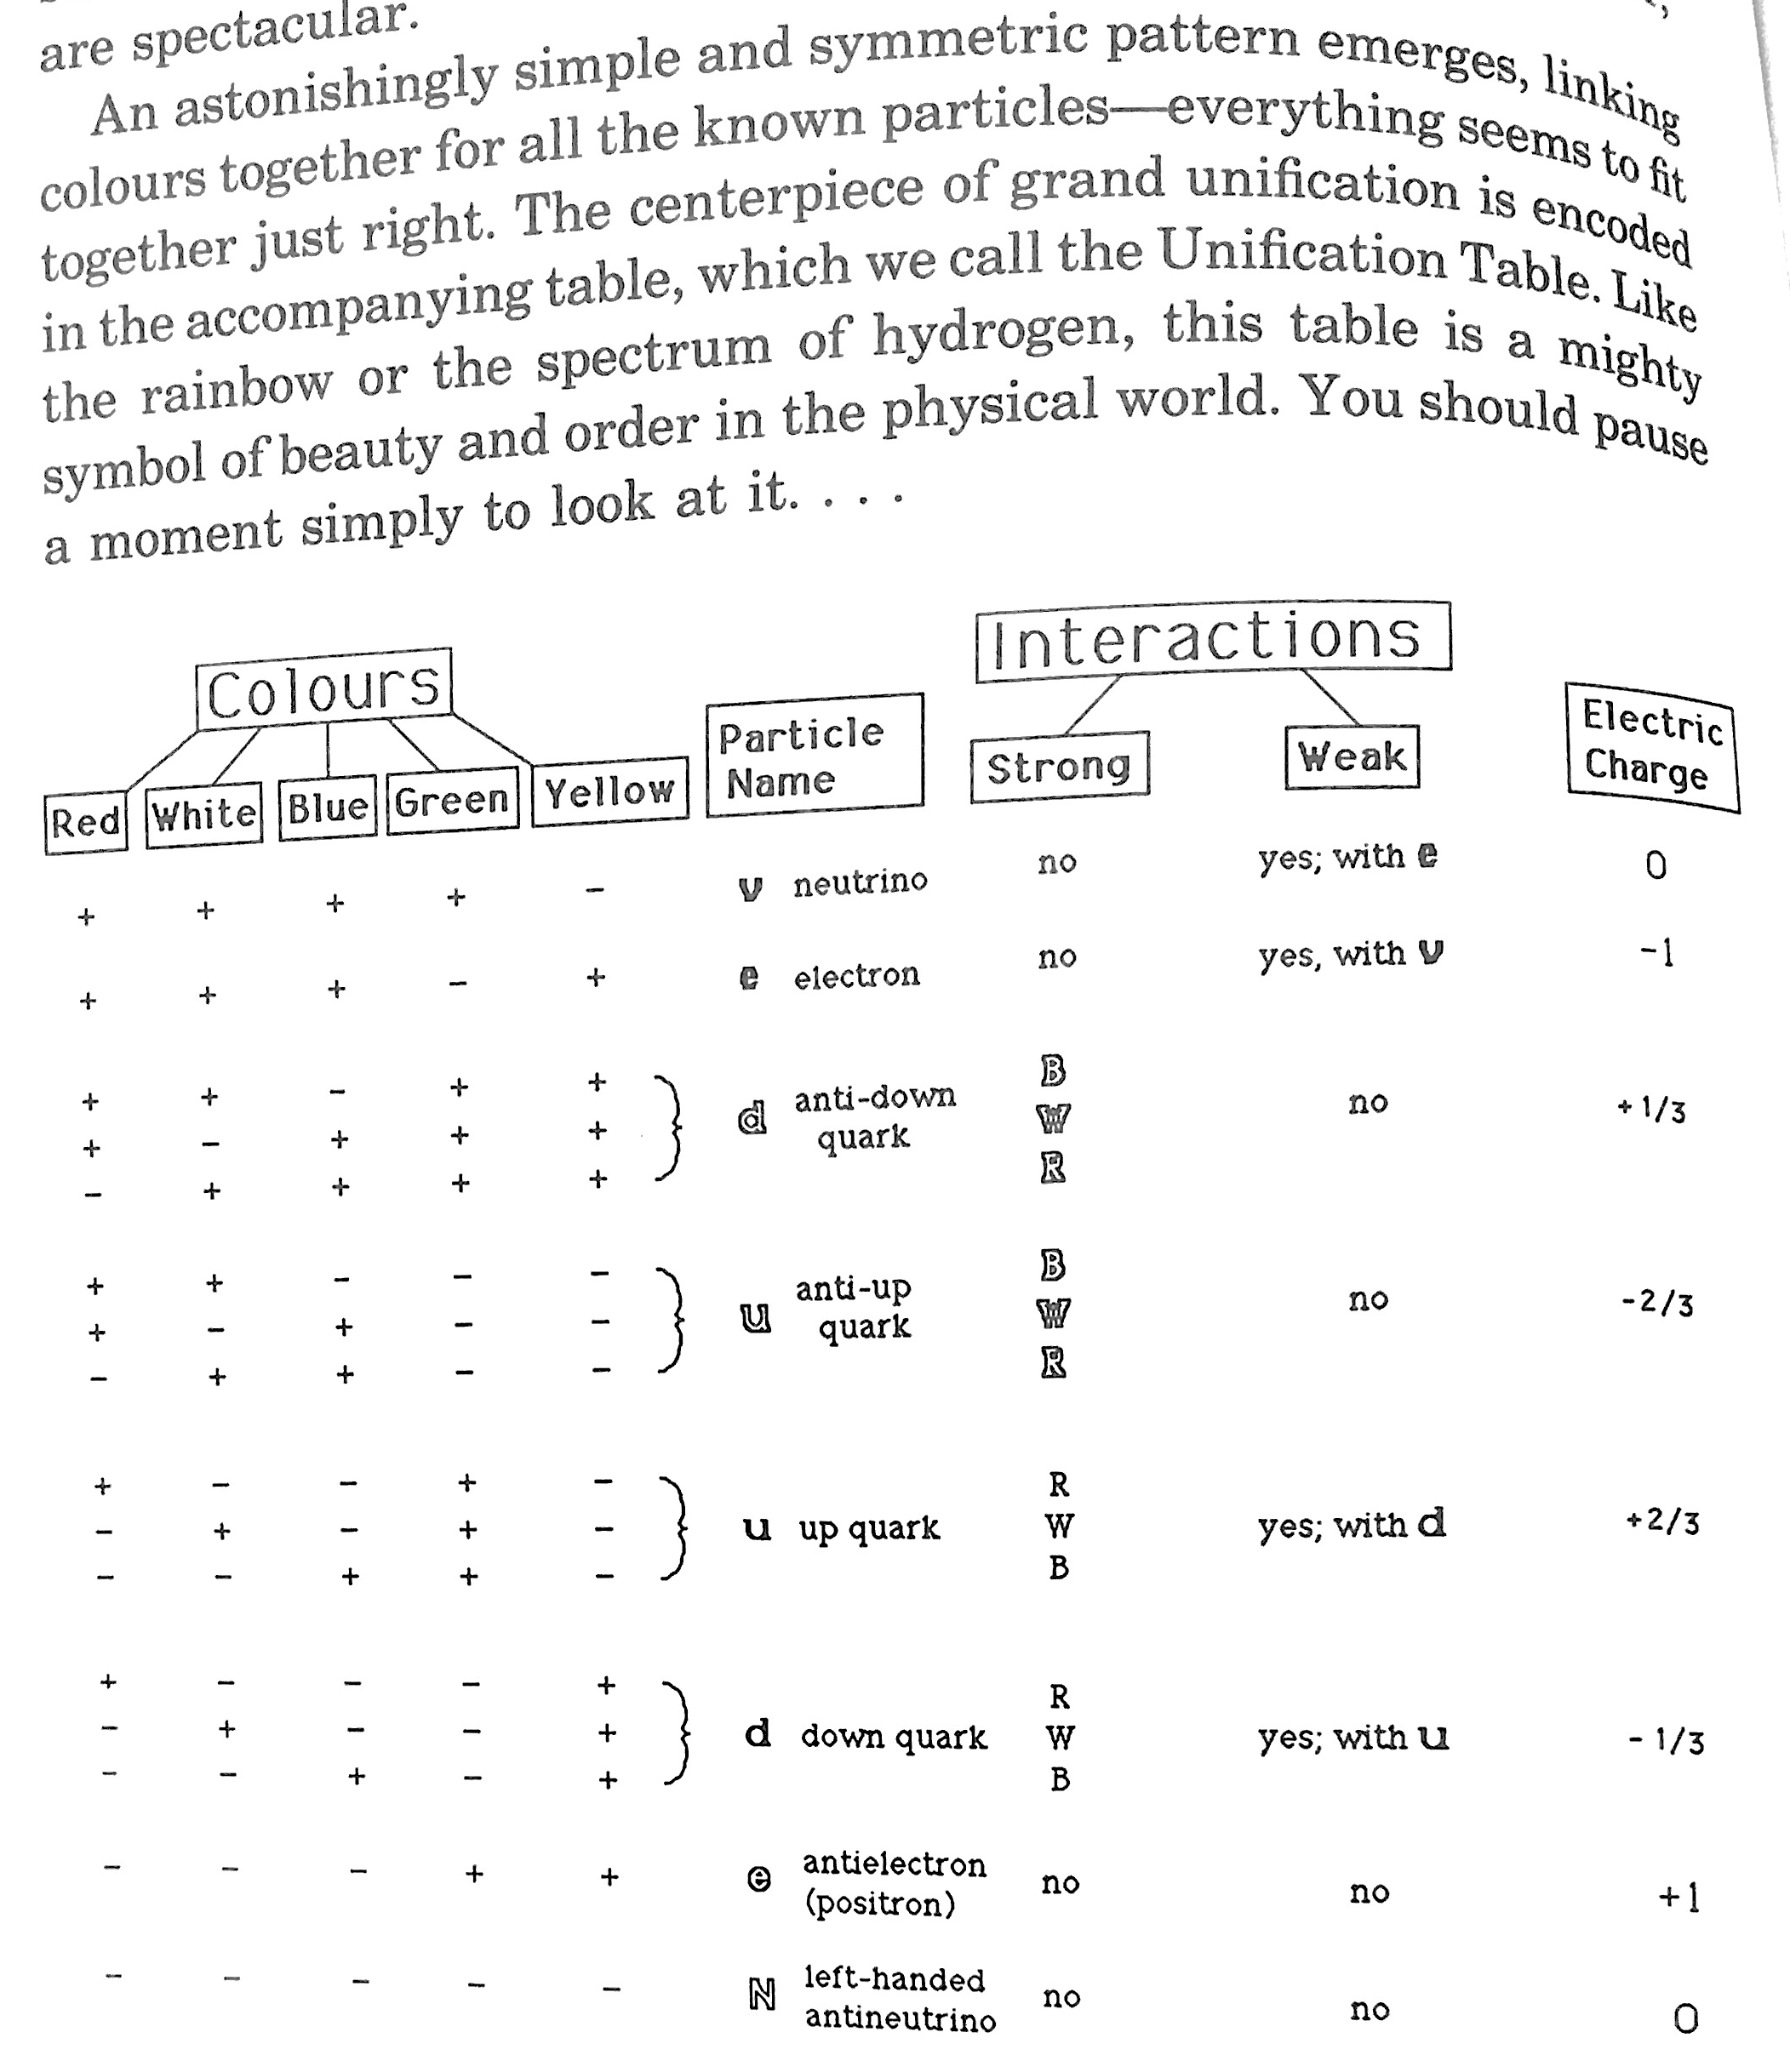
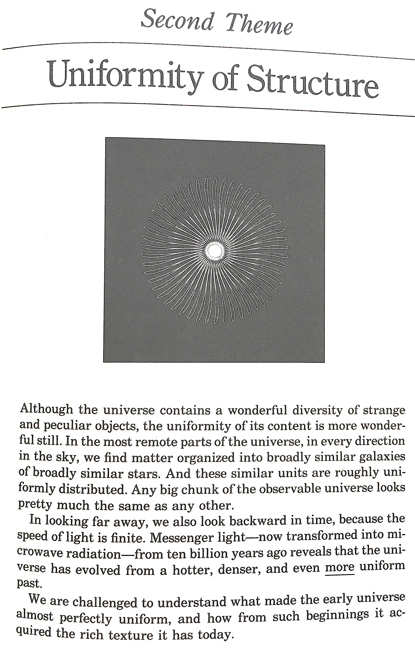
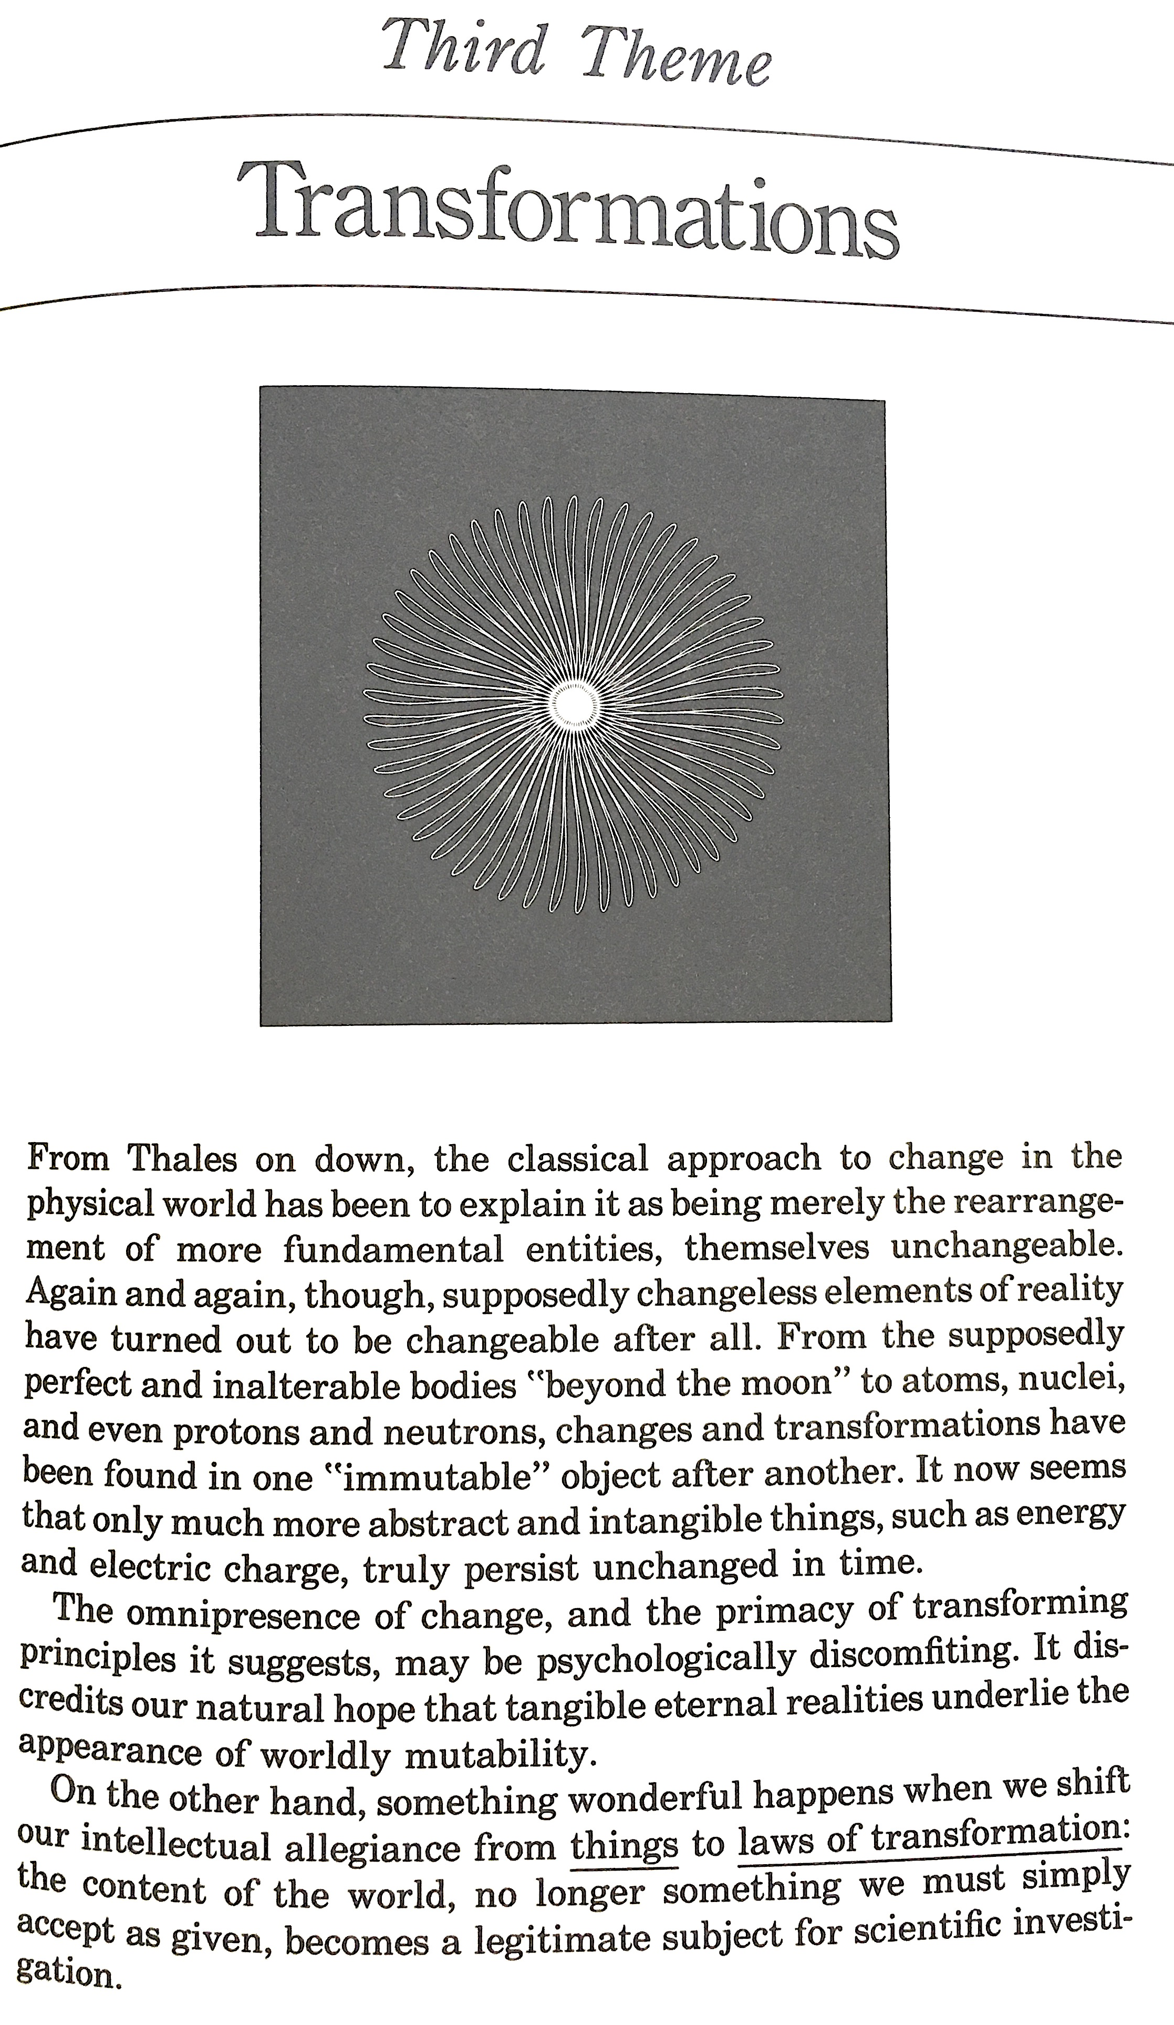
“More and more, as our understanding of fundamental physics has progressed, we have come to ascribe the rich texture of reality to ideally simple laws acting in a complex environment” (Wilczek 240).

Slide 3
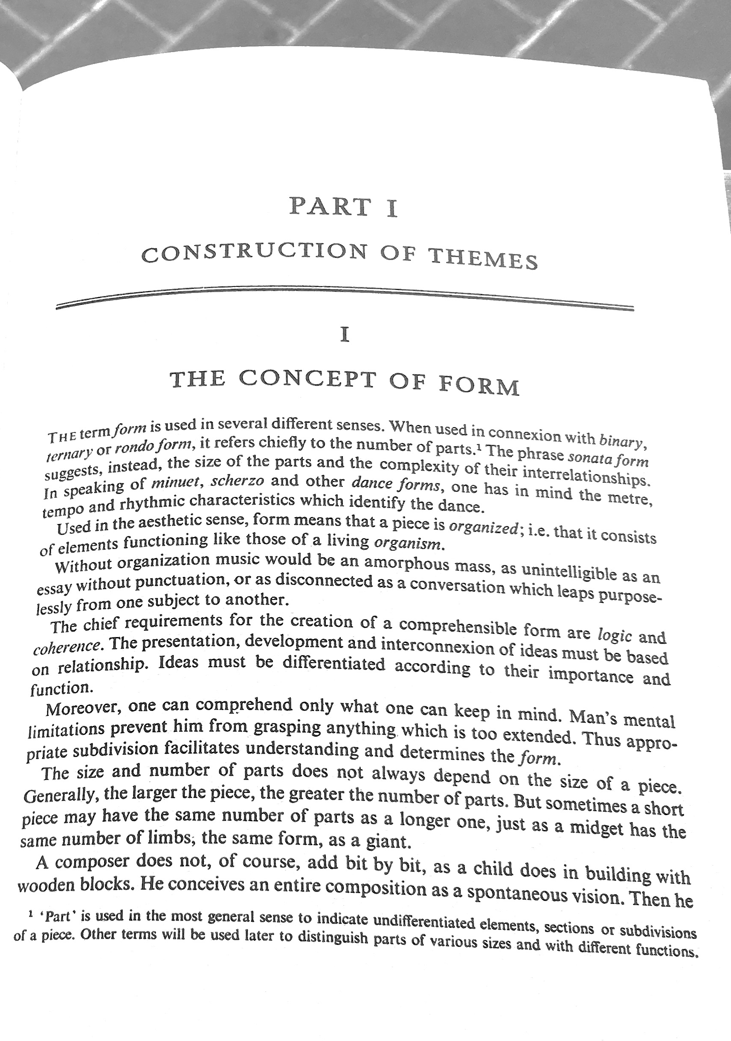
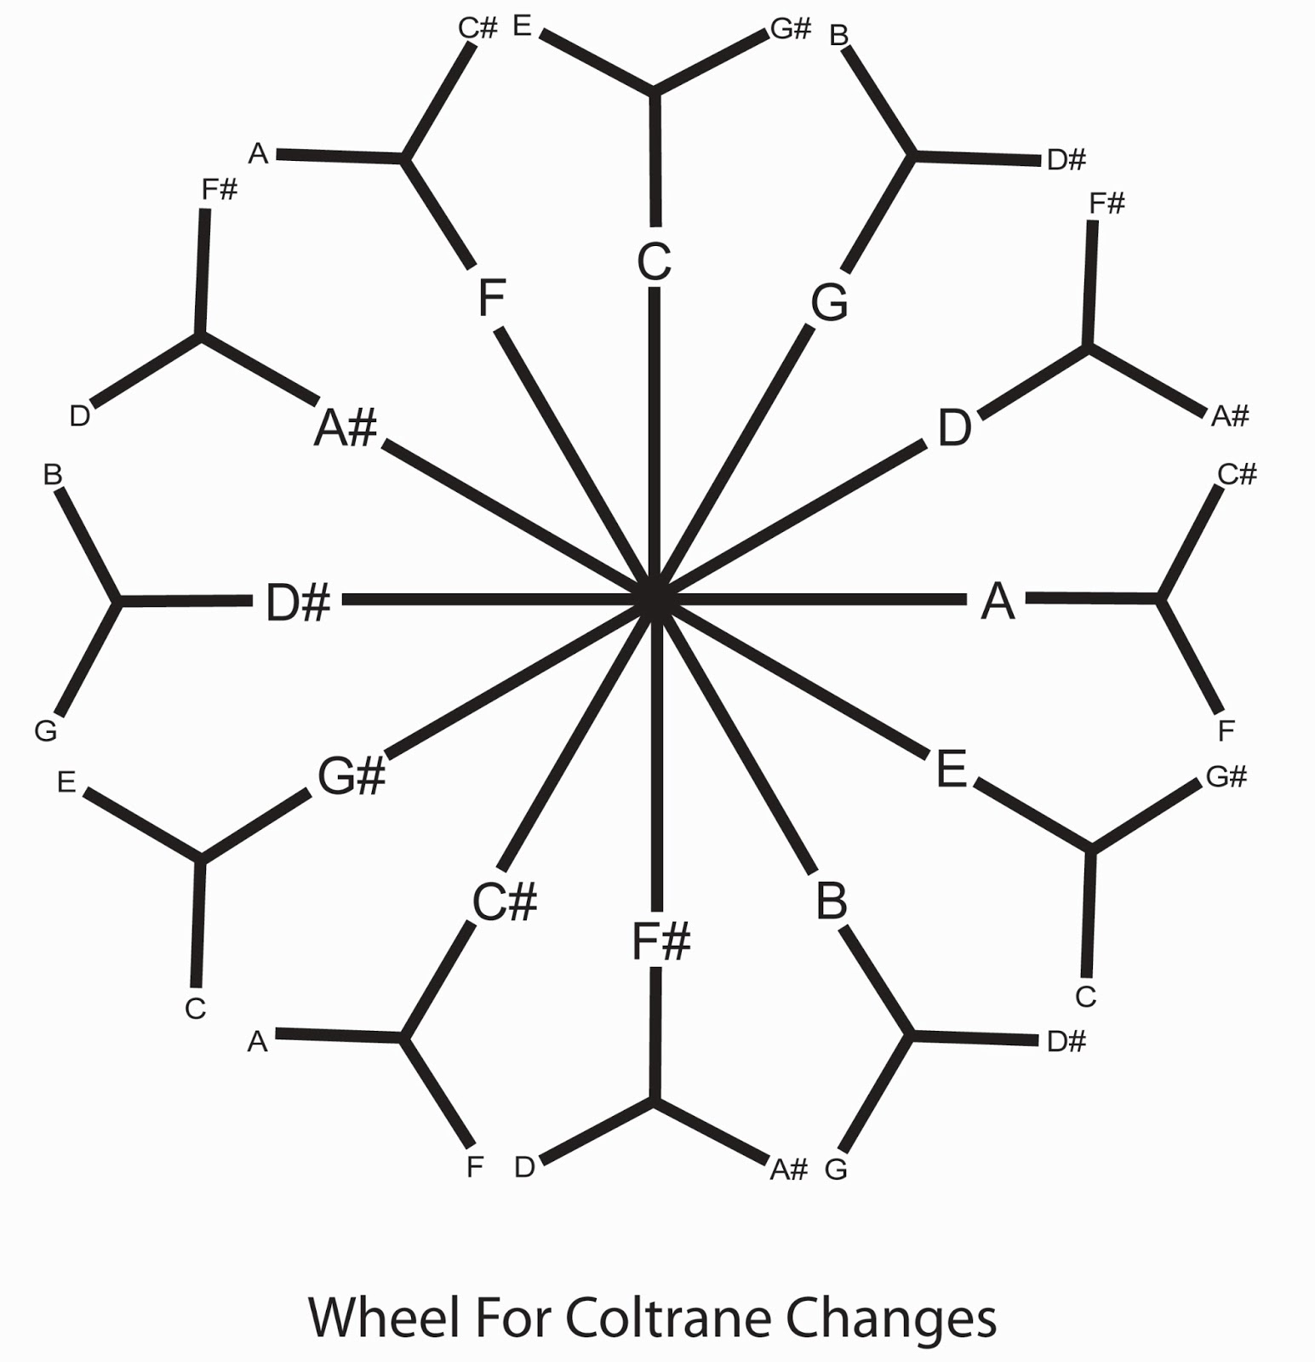
The bases of music are rhythm and harmony. Rhythm is ordered recurrence in time. Pure tones are those whose vibrations are particularly simple and periodically orderly. Tones harmonize if their intervals of tonal vibration are in rhythm – that is, when their periods are proportional.

Slide 4
form :“[a piece] consists of elements functioning like those of a living organism” relationship: presentation, development, and interconnection of ideas, differentiated according to importance and function motive: germ of the idea. “The features of a motive are intervals and rhythms, combined to produce a memorable shape or contour – which usually implies an inherent harmony” narrative: treatment and development of this initially defined motive flow: establishment of continuous flux, in perfect proportions. Through this, music produces a “stream of intention.” The ability for an idea to make maximum impact with minimal hindrance has to do with its having good flow.

Slide 5
A story, to our tastes, requires a bit of impedance of flow to make the “good stuff” have relative flavor. By determining the emotional valence of a segment of story text, then analyzing how this sentiment changes from moment to moment, a piece of literature may be plotted as a function of sentiment vs. time. Narrative architecture: “Six core trajectories form the building blocks of complex narratives”

Slide 6
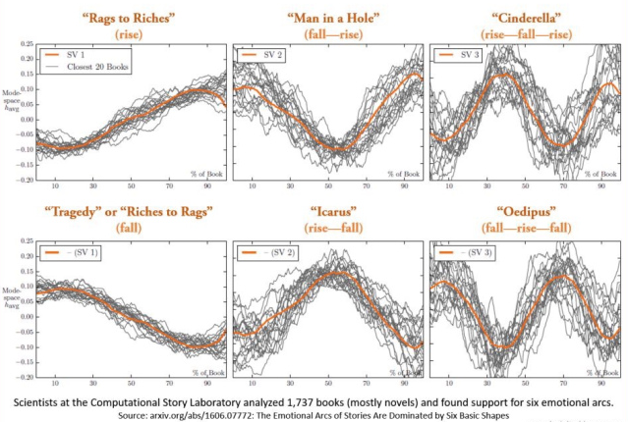

Slide 7
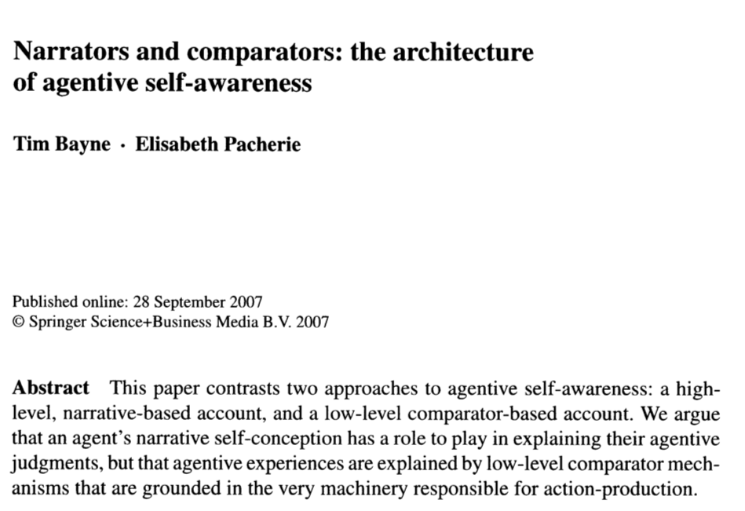
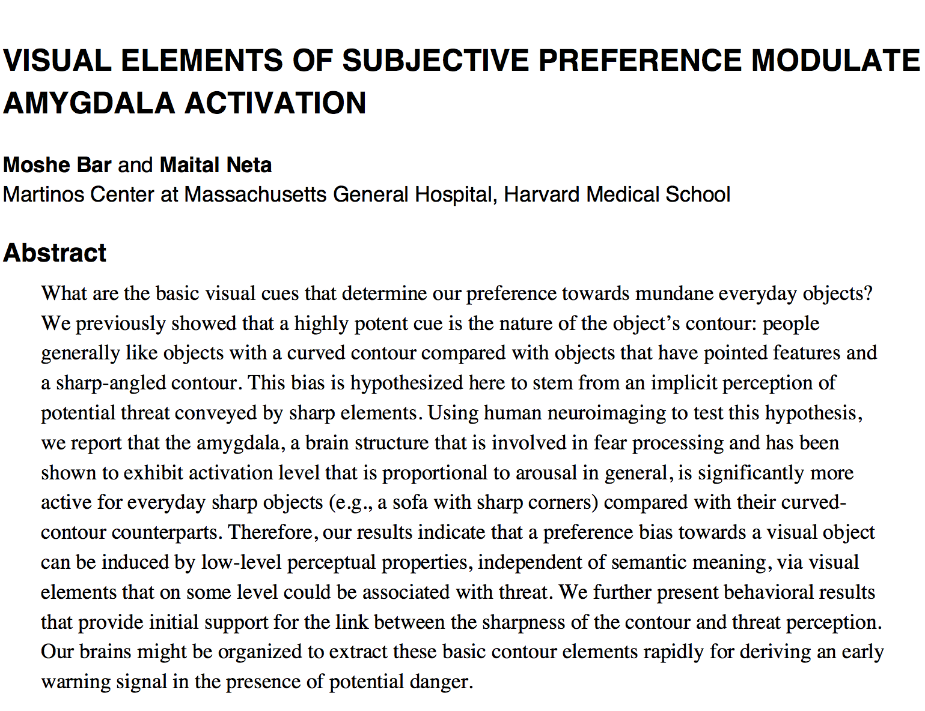
Contour is hard-wired into our brains (Bar 2192). It’s our means of creating and comparing narrative – the basis for our agentive self-awareness (Bayne 485). So sheer is our tendency to fit experiences to a model that we force continuity between some perceived cause and effect without conscious basis.

Slide 8
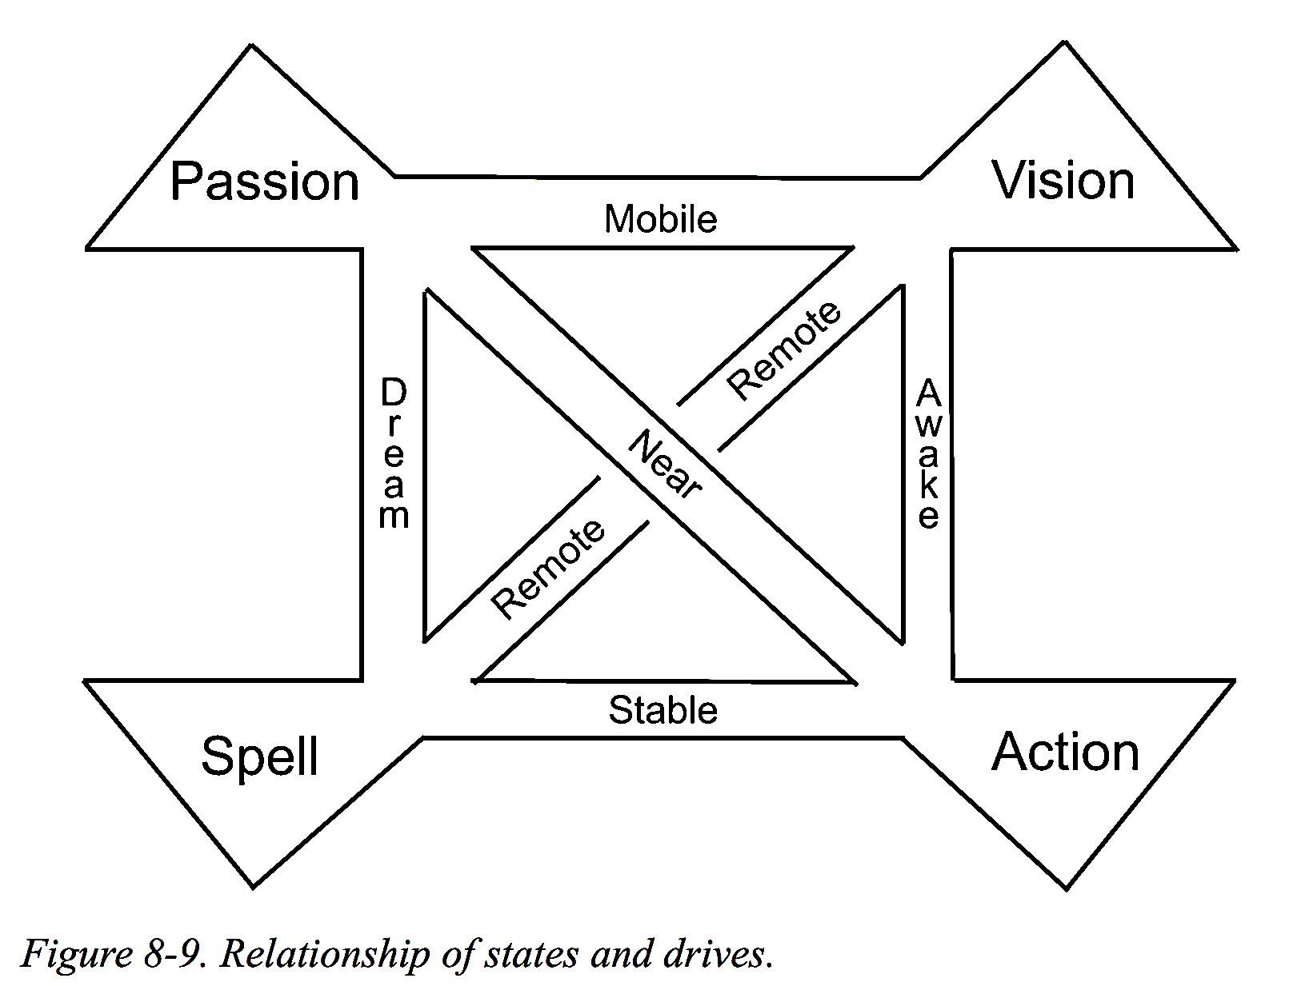
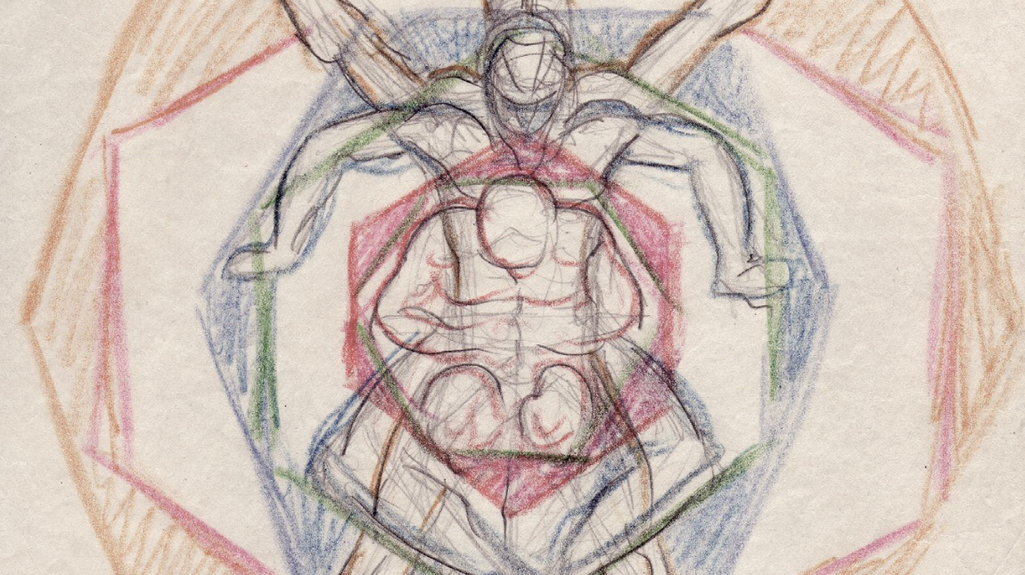

Slide 9
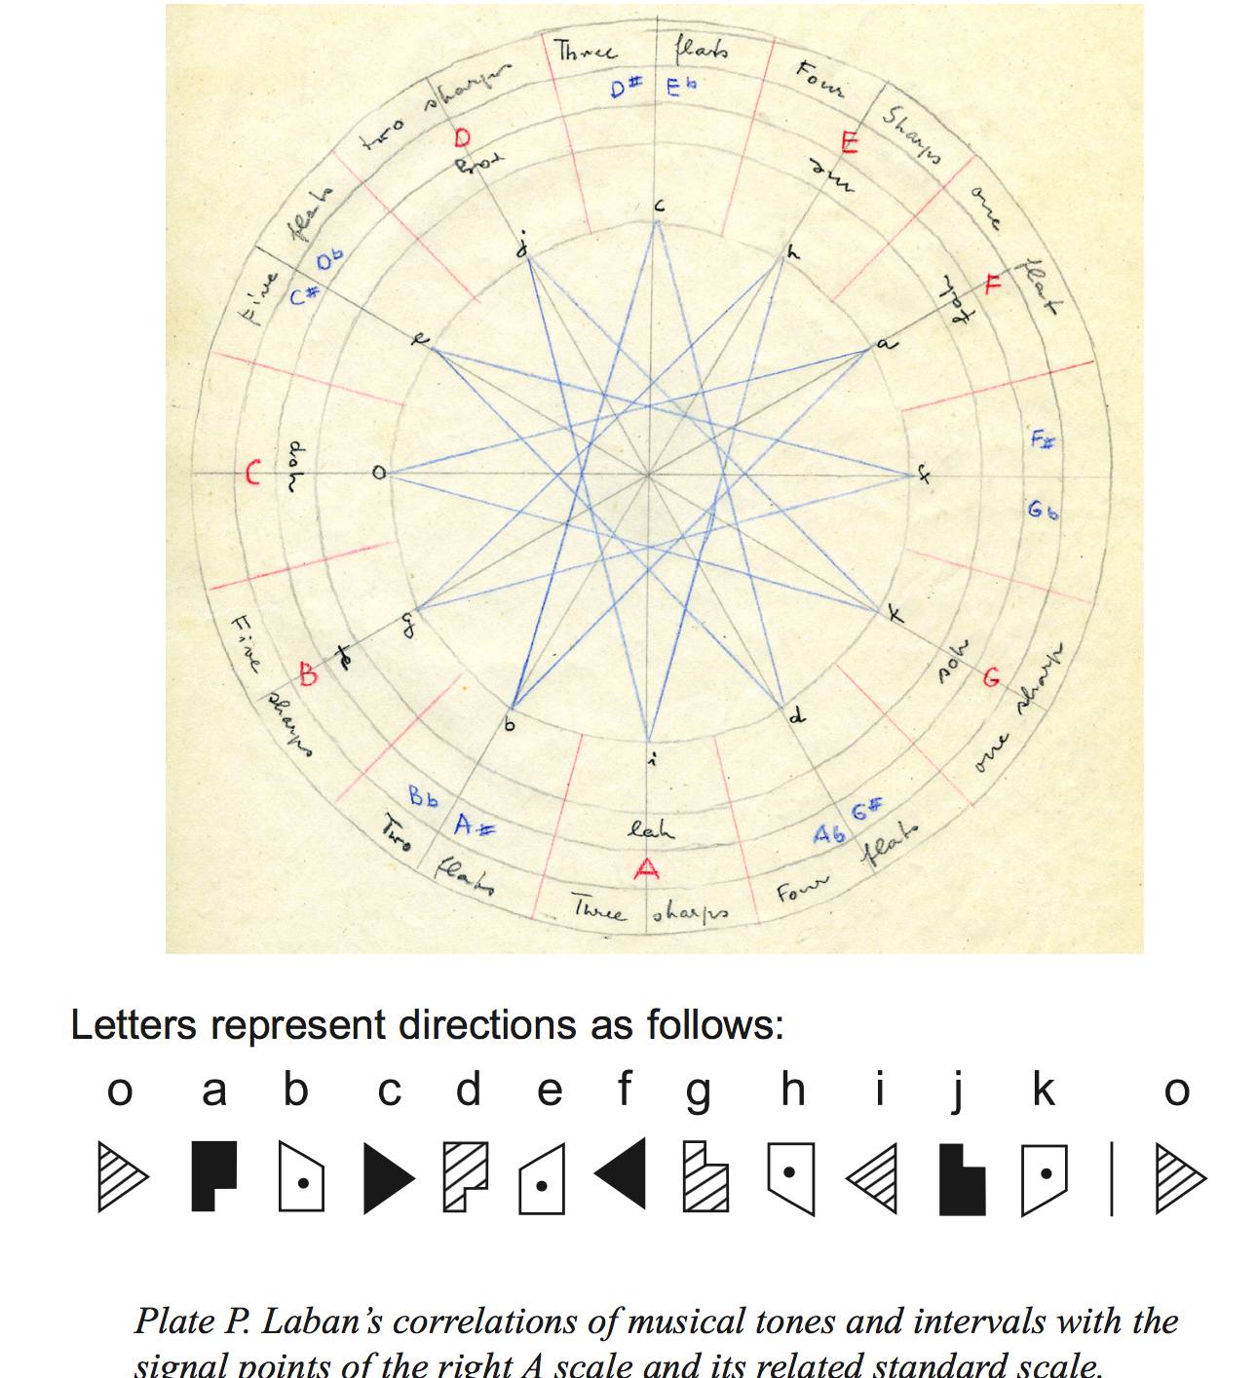
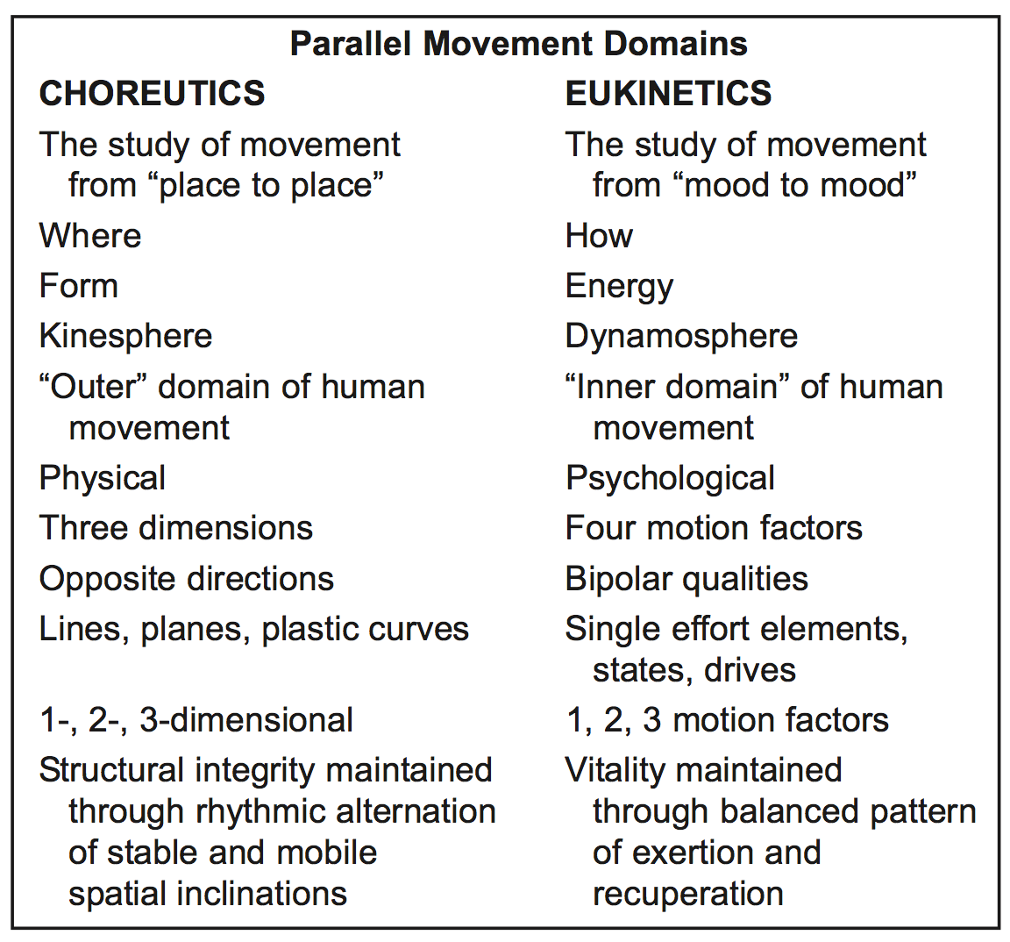

Slide 10
It may be proposed that because of these models of logic and spirit, our intuition has sense. “Everything we do, including grasping a moment of music, commences with a sort of fleeting hypothesis that is confirmed or disconfirmed; every subtle mismatch is countered by adjustments to the next anticipation” (Jourdain 302).

Slide 11
If a feeling of what is satisfying is inherently harmonic, then different relations between notes must express different feelings – the spectra of which being connected by a spirit of value and desire. Without truly sound structure, there is no balance, no storehouse, no perception of beauty, and no sustained or honest pleasure. If success is derived from some feeling of satisfaction, with satisfaction itself being derived from some harmonic progression to euphoria, then different morality codes offer varying rates of success, with differing definitions on what that success is and is surrounded by.

Slide 12
We have a value-driven, identity-forming pallet. Because this is fundamentally psychological in nature, and conceived from the structure of imparted or direct experiences, one’s reaction and narrative model can be skewed from some original self-supporting understanding and mechanic of justice. This is emotional, its logic feigned by association. This emotion begets dogma, a necessary pillar to uphold an illusory structure of identity. For there is both architectural soundness, and architectural compromise. That which is sound, in the vein of truth. Otherwise it is structurally compromised, inasmuch as it is motivated by some spirit of effection towards a fallacious vision. Such structures may be held together by partial legitimacy, lengthening its moment of apparent sustainability, but ultimately be ephemeral. It’s like the pursuit of a solid “twang” of a string – the satisfaction comes relative to the other notes, but is not certified in their tuning. A sustainable harmonic model is first based on the pure tuning of the base note, and then derivably on the tuning of the other notes relative to it. Without both rules in check, the system will swing into discordance.

Slide 13
As structure is to logic, harmony is to spirit. Spirit is empowered by story. Story distilled could be surmised as: the way things should be, and what goes horribly wrong. Narrative; as motivated by conflict, aimed at a resolution (Rosen 4). Progression; from dissonance, into harmony. Such a story, in essence, reverberates with the story of humanity. We look for a perfect spirit, to guide us to some harmonic model of the way things should be, motivated by the dissonant problems of our shared existence.

Slide 14
We see there is form. While there may be a structure of absolute integrity to which everything may rest, our tendency to lean on a form by desire allows such forms to be compromised. Emotion is critical to reasoning (Jourdain 309); and narrative is capable of manipulating some deeply-engrained psychological tendencies. “In coming to appreciate these songs, we develop a heightened perception. The rough-and-ready perception with which evolution has supplied us is leavened by an admixture of our own creation” - Frank Wilczek, Longing for the Harmonies, p.340

